Slide 1
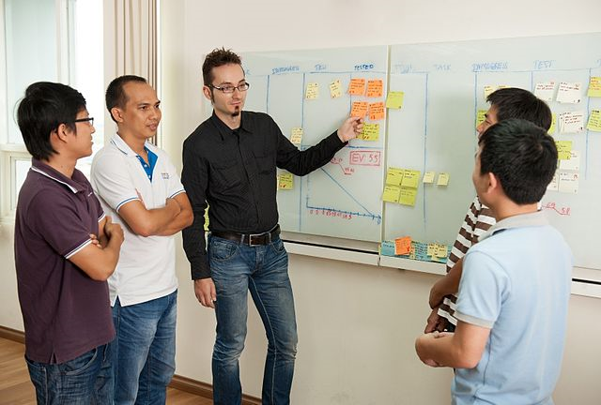
Introduction to Scrum-Agile Development
SNHU CS210 – Software Development Lifecycle
Craig O’Loughlin
photo credit Wikimedia Commons

Slide 2
What is Scrum-Agile?
Process model which focuses on adaptability and customer satisfaction (tutorialspoint, 2021)
Many projects have changing or hard to define requirements
Customer requirements tend to change or are also similarly difficult to define
Project development is iterative and incremental
“Sprint” cycles lasting 1 – 3 weeks
Working version of the product is displayed at the end of each cycle
Customer and other stakeholders can add input
Requirements can be updated as project continues
Scrum is added as a project framework
Provides tools for communication and collaboration such as daily scrum meeting

Slide 3
Individual Roles in an Agile Team (Cobb, 2015)
Product Owner
The product owner is responsible for working directly with the customer and understanding the product requirements. Will also break the requirements down into small incremental development points, referred to as “user stories”, for the rest of the team.
Developer
The developer(s) among the team is tasked with building the project increments. Provides feedback regarding what is possible development-wise during a sprint and is the subject matter expert regarding the product build.
Scrum Master
The scrum master owns the scrum-agile methodology and works continuously to incorporate this mindset among the team. Sets the example, provides the agile framework, and clears obstacles in the way of the team’s progress.
Tester
The tester(s) of the team work to define the criteria for acceptance for each user story by working with the product owner. Ensures that the development follows test driven mentality and strives to incorporate quality at each level and among each team member.

Slide 4
Typical Scrum-Agile Development Cycle (Gupta, 2018)
A backlog of user stories to be implemented is defined
User stories are selected from the backlog
Lasting 1-3 weeks, development of the chosen user stories from backlog. Daily Scrum meetings occur (15 min or less)
A new, stable version of the product is released for feedback
Next Product Version
Story 1
Story 2
…
…
Story n
Product Backlog
Sprint Planning
Sprint Cycle
Product Increment

Slide 5
Agile vs Waterfall: An Example
Scenario: build a weather application for a local news station
Waterfall Approach
Gather all requirements beforehand
Plan out total application design
Build the application in its entirety
Test the application per the requirements
Find major error, requires significant architecture rebuild
Rebuild application
Test the application per the requirements
Deploy
Customer requirements have changed
Rebuild application …
Scrum-Agile Approach
Gather only necessary requirements to begin development
Plan the first sprint increment
Develop and test the first version of the software
Submit the first version for customer review
Customer requirements have changed
Incorporate changes into next sprint
Find major error, requires significant architecture rebuild
Incorporate changes into next sprint(s)

Slide 6
Choosing the Best Development Approach
When Waterfall methods offer benefits to project management (tutorialspoint, 2021): | When Scrum-Agile methods may offer improvements (tutorialspoint, 2021):
Project requirements are well documented beforehand | The project plan is expected to evolve as the project continues
Product definition is stable | There is uncertainty regarding project requirements
Project is short | Project has a longer running life
Technology behind the project is understood and will not change | Project is using a new technology architecture

Slide 7
References:
Cobb, Charles G. (2015) The project manager’s guide to mastering agile : Principles and practices for an adaptive approach. Hoboken : Wiley.
Gupta, Hitesh. (2018) Agile methodologies in SDLC. testingcycles. http://testingcycles.com/agile-development-in-sdlc/
Tutorialspoint (2021) SDLC – agile model. Learn SDLC. https://www.tutorialspoint.com/sdlc/sdlc_agile_model.htm

